Slide 1
CHARACTERISTICS AND PHYSIOLOGICAL RESPONSE OF PLANTS TO SUN AND SHADE
GROUP 16

Slide 2
OUTLINE
Introduction
Characteristics of sunlight environment
Examples of sun plants
Physiological adaptations of sun-loving plants
Characteristics of shade environment
Examples of shade plants
Physiological adaptations of shade- loving plants
Comparative analysis: Sun vs. Shade adaptations
Conclusion

Slide 3
Introduction
Plants are sessile organisms which have evolved a wide array of adaptations to thrive in various habitats, particularly in response to differences in light availability. Light is a fundamental resource that influences the distribution and abundance of plant species in a particular ecosystem.
While certain plants excel in Sunlit environments, others excel in Shaded environments.

Slide 4
INTRODUCTION CONT’D
Sun environments: Are environments that are characterized by high light intensity and direct exposure to sunlight for a significant portion of the day.
Shaded areas: Are characterized by reduced light intensity due to partial or complete obstruction of direct sunlight .

Slide 5
Characteristics of sunlight ENVIRONMENTS
High Light Intensity
High Temperature
Direct Sunlight Exposure
Low Humidity

Slide 6
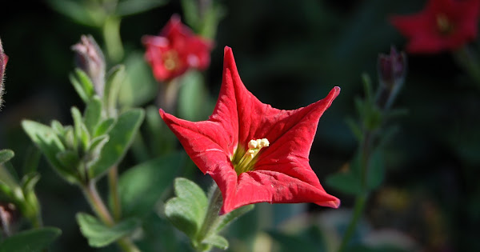
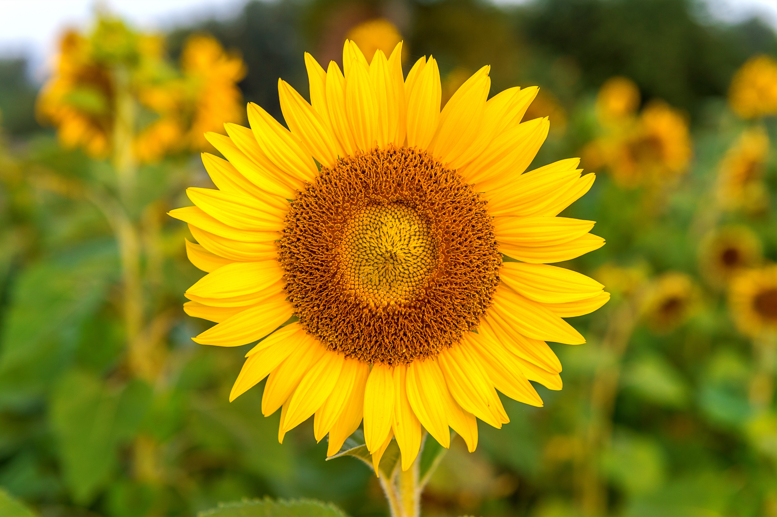
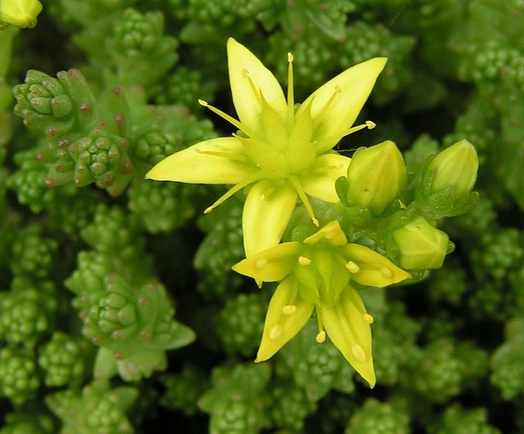
EXAMPLES OF SUN loving plants
Pertunia exserta
Sunflower
Stonecrop

Slide 7
Physiological adaptations of sun- loving plants
Leaf Structure and Morphology
Small, Thick Leaves
Waxy Cuticle
Sunken Stomata
Drought Resistance and Water Conservation
CAM and C4 Photosynthesis
Reduced Transpiration Rate

Slide 8
CHARACTERISTICS OF SHADE Environments
Low Light Intensity
Lower Temperature
Indirect or Diffused Sunlight
Higher Humidity

Slide 9
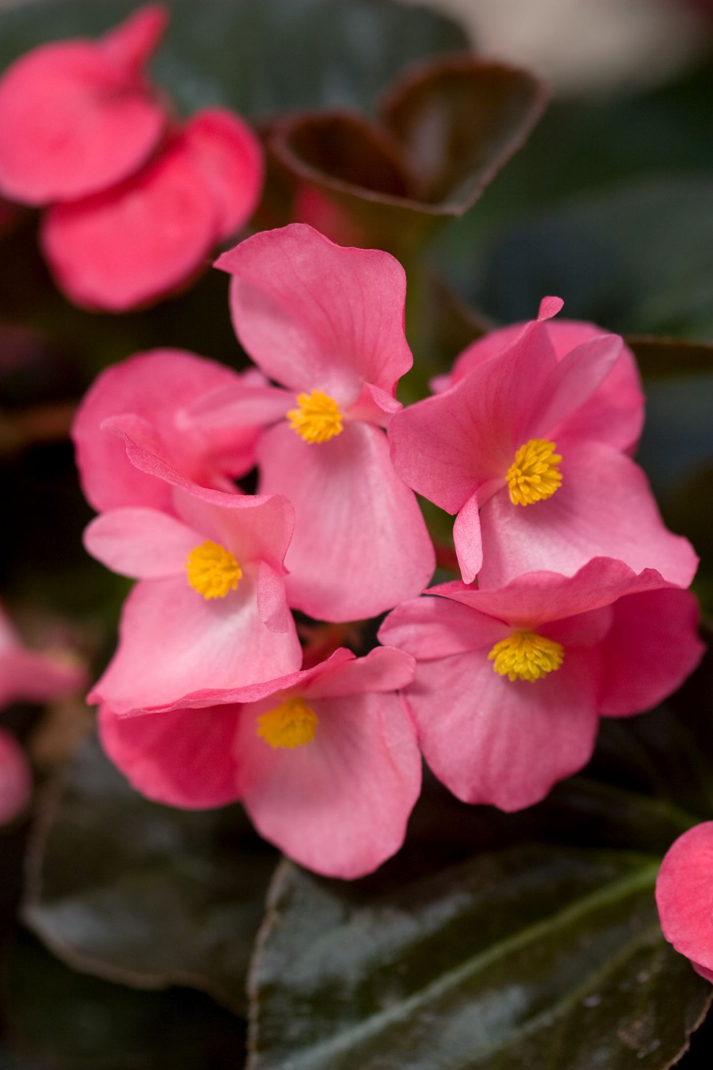
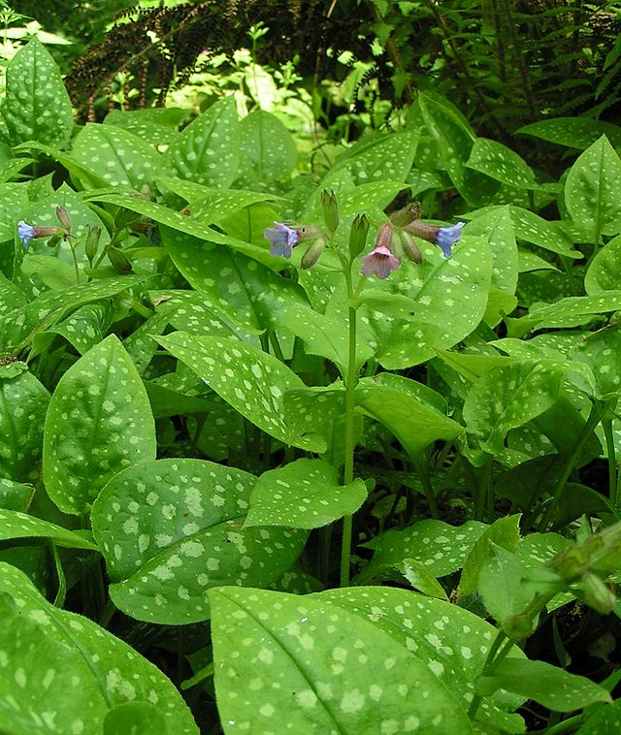
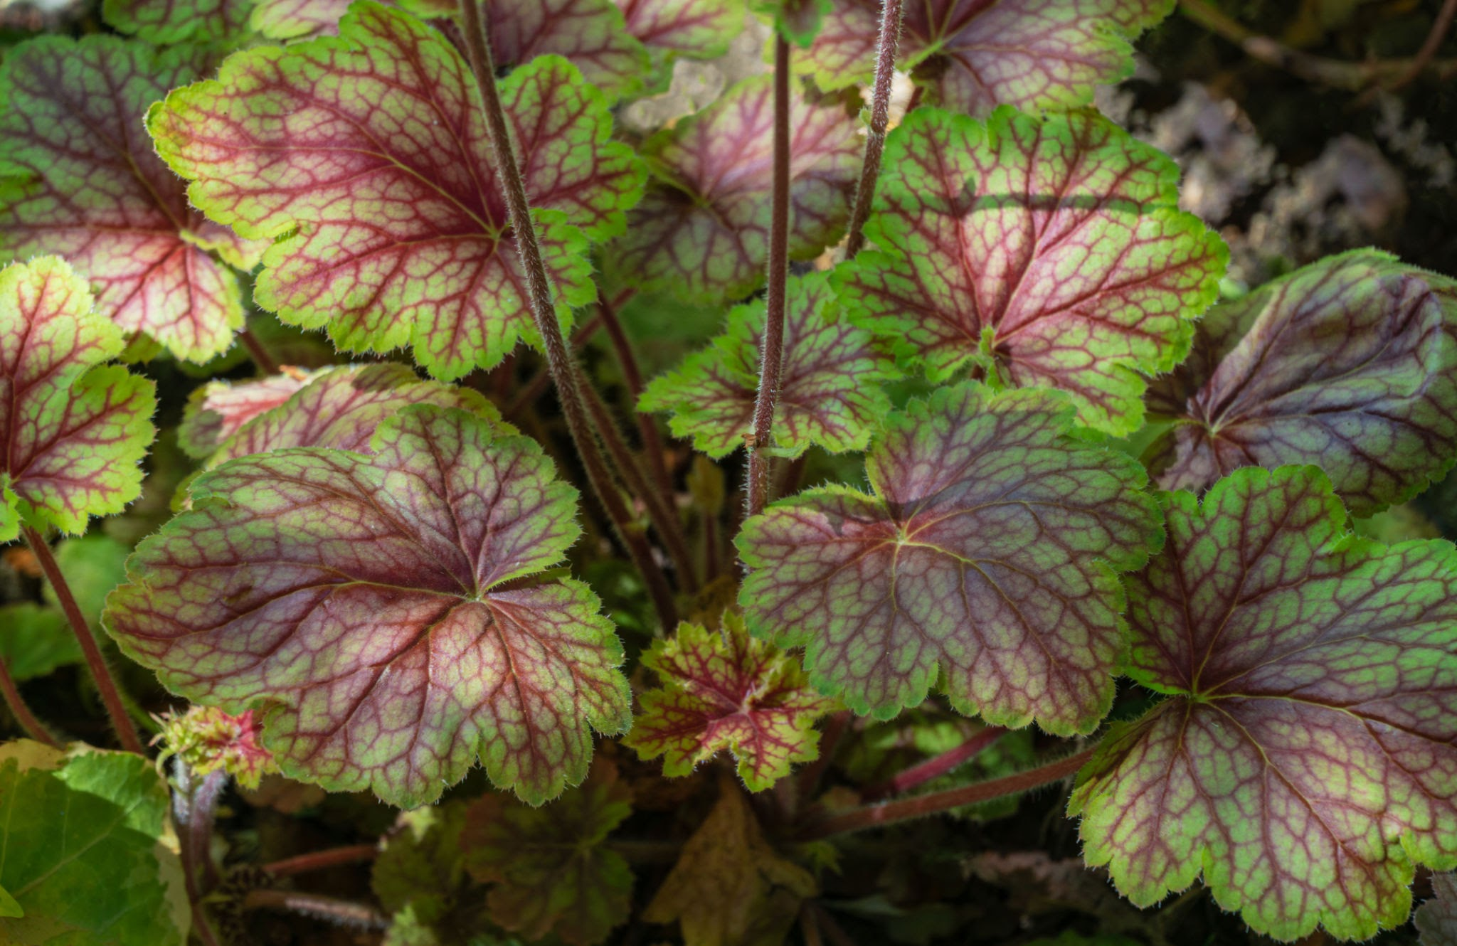
EXAMPLES OF shade loving plants
Begonia
Lungworts
Coral Bells

Slide 10
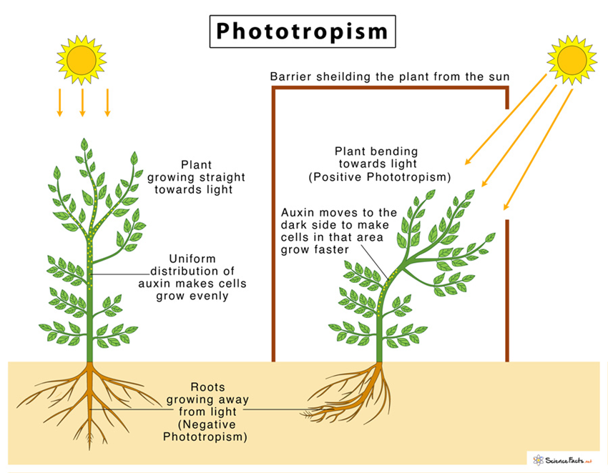
Physiological adaptations of shade- loving plants
Leaf Structure and Morphology
Large, Thin Leaves
Reduced Cuticle Thickness
Increased Leaf Surface Area
Strategies for Efficient Light Capture
Phototropism and Leaf Angle Adjustment
Clustering and Shade Avoidance Response

Slide 11
Comparative analysis:
Sun vs. Shade adaptations
Leaf Characteristics
Photosynthetic Strategies
Water and Nutrient Use Efficiency

Slide 12
CONCLUSION
Plants have evolved remarkable adaptations to cope with different light conditions. Sun-loving plants optimize light capture with thick leaves and efficient pigments. Shade-loving plants thrive in low light with larger, thinner leaves and specialized chlorophyll ratios. Understanding these responses helps us in agriculture, conservation, and creating greener environments for a sustainable future. Embracing plant diversity and preserving their habitats is vital for a healthier planet.

Slide 13
REFERENCES
Valladares, F., Niinemets, Ü., & Pearcy, R. W. (eds.). (2017). Photosynthesis in the Marine Environment. CRC Press.
Pearcy, R. W., & Sims, D. A. (1994). Photosynthetic acclimation to changing light environments: scaling from the leaf to the whole plant. Advances in Photosynthesis and Respiration, 3, 263-287.
Björkman, O., & Demmig-Adams, B. (1994). Regulation of photosynthetic light energy capture, conversion, and dissipation in leaves of higher plants. In E.-D. Schulze & M. M. Caldwell (Eds.), Ecophysiology of Photosynthesis (pp. 17-47). Springer, Berlin, Heidelberg.
Smith, W. K., & Nobel, P. S. (1977). Leaf orientation, sunflecks, and photosynthesis in Atriplex lentiformis (Torr.) Wats. Plant Physiology, 59(6), 1008-1011.
Boardman, N. K. (1977). Comparative photosynthesis of sun and shade plants. Annual Review of Plant Physiology, 28(1), 355-377.
Valladares, F., Wright, S. J., Lasso, E., Kitajima, K., & Pearcy, R. W. (2000). Plastic phenotypic response to light of 16 congeneric shrubs from a Panamanian rainforest. Ecology, 81(7), 1925-1936.

Slide 14
GROUP MEMBERS
Frimpong Abigail Foriwaah
Kyeremateng Esther Adoma
Anyemi Eva Dedaa
Kenney Collins Tetteh-Adjor
Amponsah Derek
Adongo Ernest

Slide 15
THANK YOU

